Slide 1


Introduction to
Robotic Process Automation
Title of the Project
Your Register No. 2116220701217
Name : Ramya P
Guide Name : Dr. Duraimurugan. N
Designation and Department : Associate Professor (SG) Department of Computer Science and Engineering

Slide 2
Abstract
Objective:Develop an automated system to recommend personalized skincare routines
using UiPath.
Input Collection: Gathers user data such as skin type, concerns, and lifestyle factors
via a user-friendly interface.
(databases, Excel, CSV) and generate standardized reports (PDF, Excel).
Email Automation: Automatically attach reports to emails and send them to designated
recipients using email clients like Outlook or Gmail.
Personalized Recommendations: Identifies suitable products tailored to the user’s
specific needs, including concerns like acne, aging, or sensitivity

Slide 3
Need for the Proposed System
Growing Demand for Personalization:
Increased consumer preference for tailored skincare routines addressing unique
skin needs and concerns.
Time and Effort Optimization:
Manual research and selection of skincare products are time-consuming and
prone to errors.
Automation streamlines the process, saving time for users.
Data-Driven Precision:
Personalized recommendations based on user-specific data improve
effectiveness and satisfaction.
User Accessibility:
Simplifies complex skincare decisions with an easy-to-use automated system.
Market Demand for Automation:
Addresses the need for smart, automated tools in the personal care industry.

Slide 4
Advantages of the Proposed System
Personalization at Scale:
Provides tailored skincare routines for users based on individual preferences
and skin conditions.
Time-Saving:
Automates data collection, analysis, and recommendation processes,
reducing the time spent on manual research.
High Accuracy:
Minimizes errors in recommendations by relying on precise data extraction
and processing.
User-Friendly:
Features an intuitive interface for easy input and seamless interaction with
the system.
Cost-Effective:
Reduces the need for professional consultations or trial-and-error product
purchases.

Slide 5
Literature Survey
Paper 1: "Automated Recommendation Systems for Personalized Skincare" by J. Smith and A. Taylor
Advantages:
Provides personalized skincare recommendations.
Reduces trial-and-error product selection.
Efficient for large datasets and multiple users.
Disadvantages:
Complex to implement and maintain.
High computational costs.
Raises data privacy concerns.
Paper 2: "Role of RPA in Enhancing Skincare Solutions" by R. Patel and L. Kumar
Advantages:
Automates routine processes like data handling and recommendations.
Easy to integrate with existing systems.
User-friendly and simple to adopt.
Disadvantages:
Limited to predefined rules, lacking advanced intelligence.
Recommendations may not adapt to new trends.
Heavily depends on accurate user inputs.

Slide 6
Main Objective
Automate Report Generation: Develop a system to automatically generate daily
reports by fetching data from predefined sources like databases, Excel, or CSV files.
Streamline Report Distribution: Automate the emailing process, attaching reports,
and sending them to designated recipients at a scheduled time.
Eliminate Manual Intervention: Reduce human effort in creating, processing, and
distributing daily reports, ensuring consistency and accuracy.
Enhance Efficiency: Improve operational efficiency by automating repetitive tasks,
freeing up resources for more strategic activities.
Ensure Timely Delivery: Guarantee that reports are delivered promptly and
consistently to the right recipients at the right time.
Support Multiple Departments: Provide a flexible solution for various departments
(e.g., sales, HR, operations) that require daily or regular reporting.

Slide 7
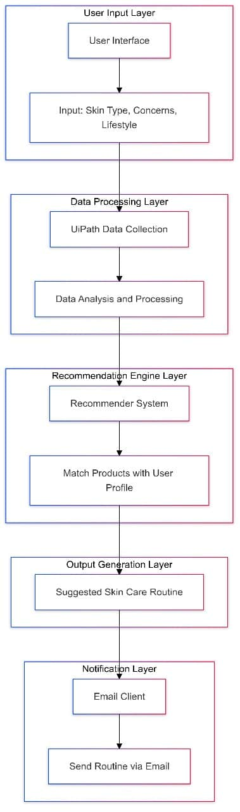
Architecture

Slide 8
System Requirements
Hardware Requirements
Processor:Intel i5 or equivalent (minimum), i7 or higher (recommended).
2. RAM:8 GB (minimum), 16 GB or higher (recommended) for efficient processing.
3. Storage:256 GB SSD (minimum) for faster performance.
4. Network: Stable internet connection for email integration and remote database access.
5. Peripherals:Keyboard and mouse.
Software Requirements
Operating System:Windows 10 or later (recommended).
UiPath Studio:Latest version with license or community edition for development and deployment.
Database/Spreadsheet Tool:Microsoft Excel (or equivalent software like Google Sheets) for storing product and user data.
Email Client:SMTP server setup (e.g., Gmail, Outlook) for automated email notifications.
Other Utilities:PDF viewer for documentation.
Browser (Google Chrome or Firefox) for testing and additional tasks.

Slide 9
Functional Description
Module 1: User Data Collection and Processing
Data Collection: Gathers user inputs such as skin type, concerns, and lifestyle factors.
Data Validation: Ensures the accuracy and completeness of the collected data.
Data Storage: Stores user data temporarily for processing in a structured format (e.g., Data Table).
Module 2: Email Sending and Distribution
Email Creation: Composes an email with the generated report attached.
Recipient Management: Sends emails to predefined or user-specified recipients.
SMTP Protocol: Uses SMTP to send emails automatically at scheduled times.
Error Handling: Monitors for errors and alerts administrators when issues occur.

Slide 10
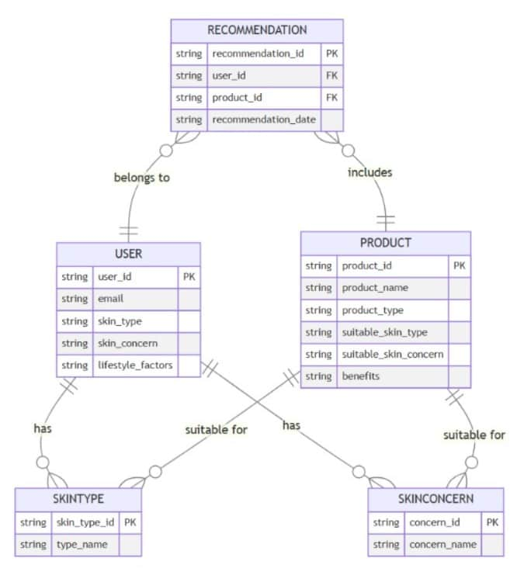
Table Design

Slide 11
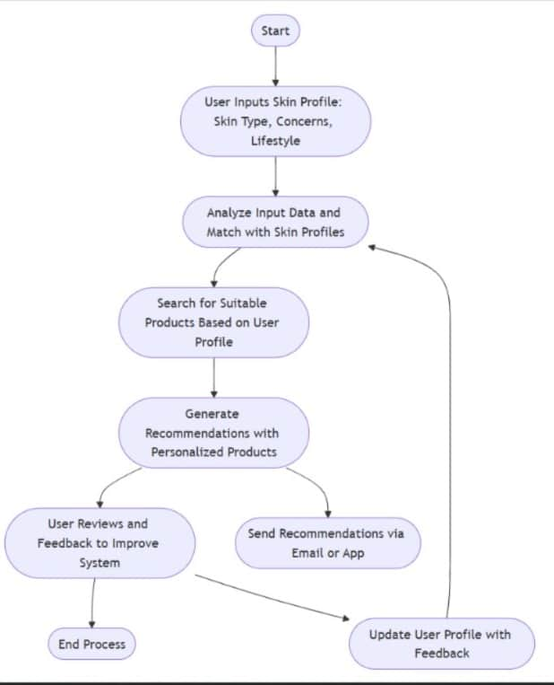
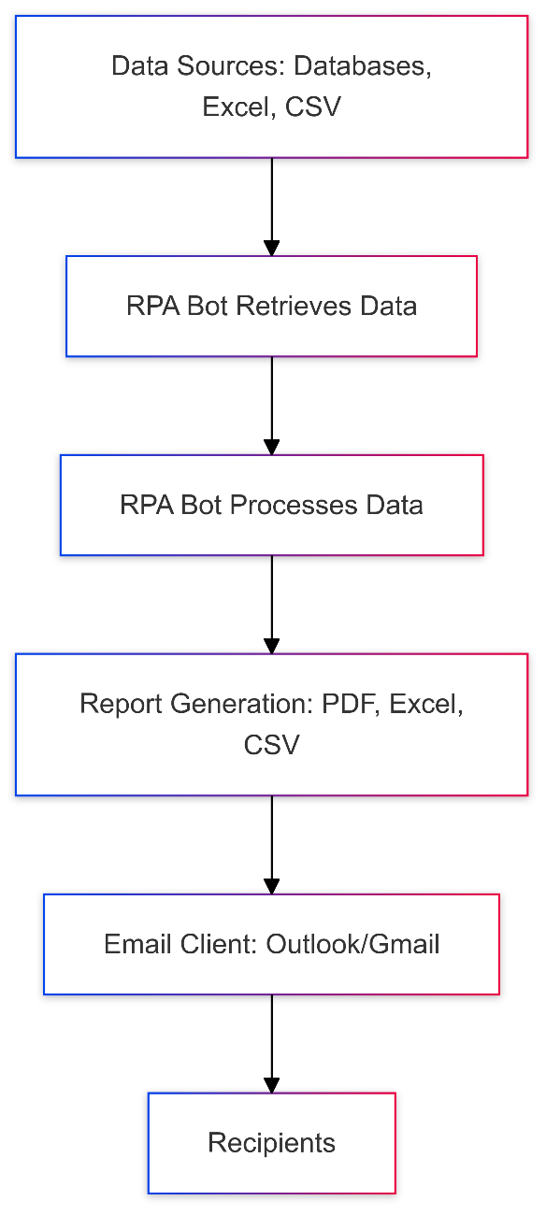
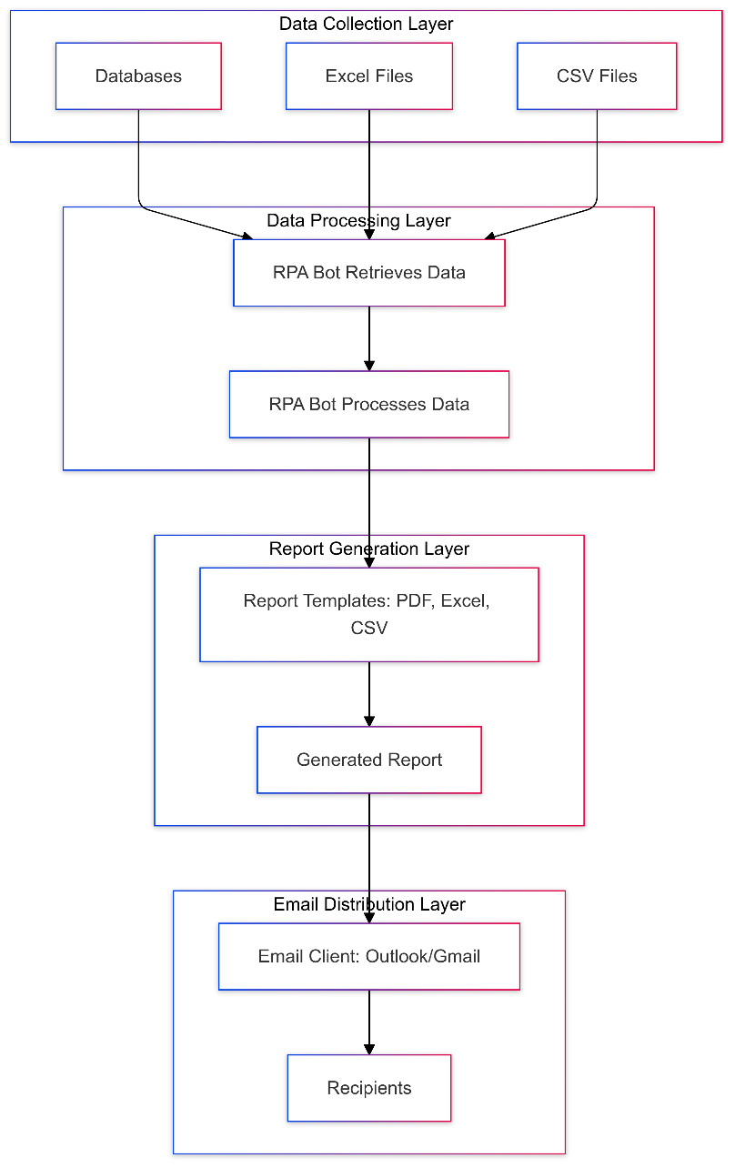
Process Design

Slide 12
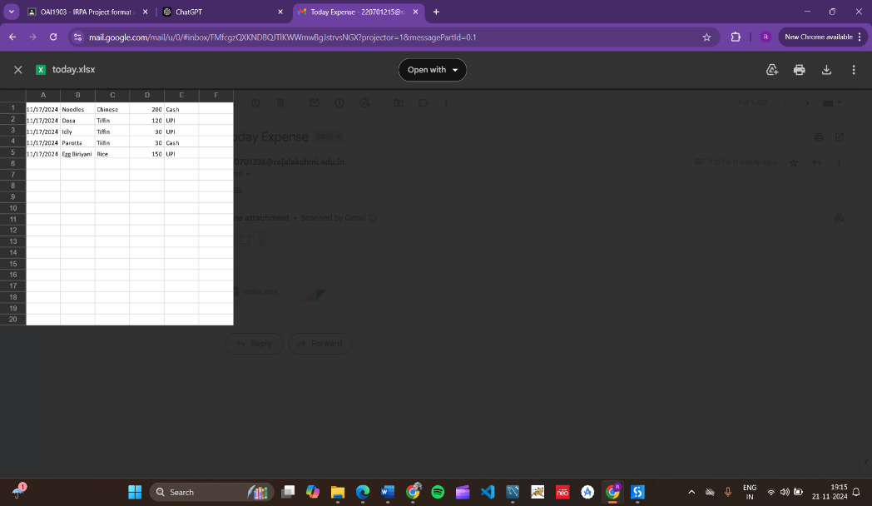
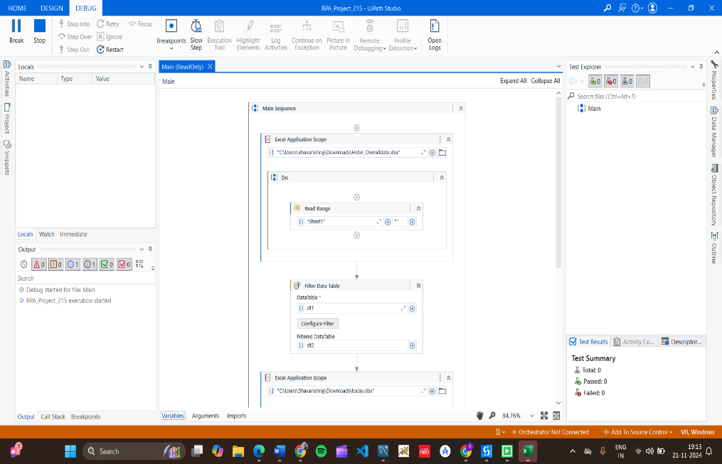
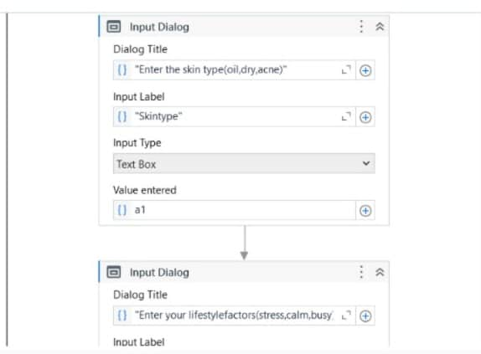
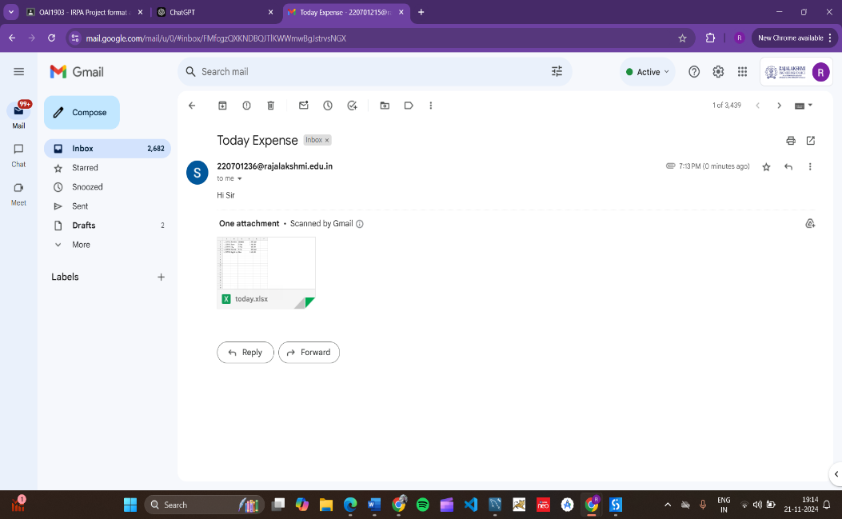
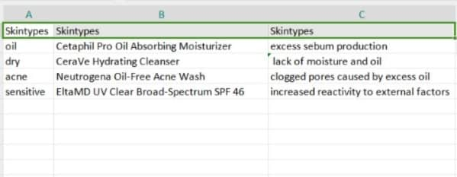
Implementation
The Workflow is executed and now the original data is extractedf rom an excelfile and output ismailed to the user
The generated report is mailed to the recipient using the SMTP Activity.

Slide 13
Conclusions
Personalization at Scale:
The system effectively provides personalized skincare routines based on individual
skin types, concerns, and lifestyle factors, improving user satisfaction.
Automation Benefits:
By leveraging UiPath’s RPA capabilities, the process of gathering user data,
recommending products, and sending emails is automated, saving ,reducing human error,time.
Enhanced User Experience:
A user-friendly interface ensures easy interaction, email notifications ensures that user
receive their personalized skincare recommendations directly in their inbox.
Efficient Data Handling:
The use of databases (Excel or Data Tables) ensures smooth data storage, comparison,
and retrieval, making the recommendation system more efficient.
Scalable and Flexible:
The system can easily scale to accommodate more users or integrate additional
skincare products and concerns, making it adaptable to evolving user needs.

Slide 14
Future Enhancements
AI and Machine Learning Integration:
Incorporate machine learning algorithms to continuously improve the accuracy of skincare recommendations based on user feedback and changing trends in skincare science.
Use AI to predict future skin issues and offer preventive skincare suggestions.
Real-Time Skin Analysis:
Integrate with devices or mobile apps that can perform real-time skin analysis (e.g., using image recognition or sensors) to provide even more accurate and personalized recommendations.
Expanded Product Database:
Include a wider variety of skincare products, including natural or organic options, to cater to a broader audience.
Update the database regularly to include new products or formulations based on user preferences and market trends.
Cross-Platform Compatibility:
Develop mobile and web applications for easier access and interaction, allowing users to input data and receive recommendations seamlessly across multiple devices.

Slide 15
IEEE Paper
Personalized Skincare Product Recommendation System Using Content-Based Machine Learning
Author(s): Not specified in the preview
Facial Skincare Product Suggestion with Product Popularity and Post Recommendation Care
Author(s): Not specified
Artificial Intelligence Based Smart Cosmetics Suggestion System Based on Skin Condition
Author(s): Not specified
Efficient Net-Based Expert System for Personalized Facial Skincare Recommendations
Author(s): Not specified

Slide 16
References
"A Framework for Personalized Skincare Recommendations Based on Skin Types and User Preferences"
This paper discusses an automation model using machine learning techniques to classify skin types and recommend products
"E-Mail Assistant – Automation of E-Mail Handling and Management using RPA" Focuses on automating email tasks like drafting and sending reports via RPA.
"Robotic Process Automation: In-Depth Analysis of Advanced Automation
Techniques and Technologies" Provides an overview of RPA technologies applicable to automating tasks like
report generation.

Slide 17
Queries

Slide 18
Demonstration

Slide 19
Thank You

